Slide 1

Calculator
C++ PROJECT
TEAM MEMBERS [ VARA PRASAD, HEMANTH, KATYAYANI, HARSHITHA ]

Slide 2
Introduction to Calculator
Understanding the Calculator Application
A calculator is a tool designed to perform arithmetic and complex mathematical operations. This project involves building a command-line calculator in C++ that supports basic operations, providing a simple and efficient user interface.

Slide 3
Importance of Calculator
Why Calculators Matter in Daily Life
Calculators play a vital role in fields such as education, engineering, finance, and science. They eliminate human error, save time, and allow users to perform complex mathematical operations quickly and accurately with minimal effort.

Slide 4
Algorithm of Calculator
Step-by-step execution flow of the C++ Calculator
Input & Operation Selection
Compute & Display Result
The program starts and displays a menu: 1=Addition, 2=Subtraction, 3=Multiplication, 4=Division, 5=Square Root, 6=Exponent. The user enters a choice, and a switch statement processes the selected operation accordingly.
Based on the user's choice, two numbers are taken as input (or one for Square Root). The program validates input (checks for zero in division, negative in sqrt), computes the result using built-in functions, displays the output, and stops the program.

Slide 5
System Architecture
Layered modular design for clean separation of concerns
Presentation Layer
Application / Control Layer
Business Logic Layer
Handles all user interaction through the console. Displays the menu, accepts keyboard input, and shows results or error messages to the user.
Contains core mathematical operations, kept independent from the UI. Includes Basic Module: add(), subtract(), multiply(), divide() and Advanced Module: squareRoot(), power().
Acts as coordinator between input and computation. Reads the selected operation, validates the request flow, calls the correct calculator function, and manages overall execution sequence.

Slide 6
Source Code
C++ Calculator — Core Implementation
Headers & Functions
Advanced & Menu
Main Function
#include<iostream>
#include<cmath>
double add(double a,double b){return a+b;}
double subtract(double a,double b){return a-b;}
double multiply(double a,double b){return a*b;}
double divide(double a,double b){
if(b==0) throw "Division by zero";
return a/b;}
double squareRoot(double a){
if(a<0) throw "Invalid";
return sqrt(a);}
double power(double base,double exp){
return pow(base,exp);}
void showMenu(){
cout<<"1.Add 2.Subtract"
<<"3.Multiply 4.Divide"
<<"5.Sqrt 6.Power 0.Exit";}
int main(){
int choice; double a,b,result;
do{ showMenu(); cin>>choice;
if(choice==5){cin>>a;}
else{cin>>a>>b;}
switch(choice){
case 1:cout<<add(a,b); break;
case 2:cout<<subtract(a,b);break;
case 4:cout<<divide(a,b);break;}
}while(choice!=0);}

Slide 7
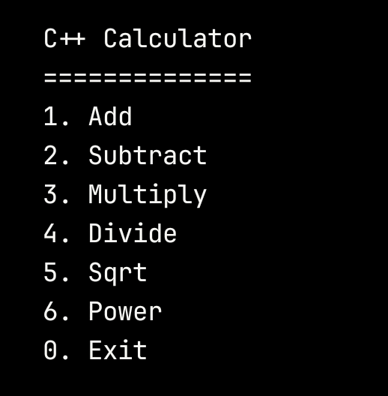
Program Output
Sample Execution — C++ Calculator
Choice: 1 → Add
Input: 10, 5 → Result: 15
Choice: 4 → Divide
Input: 20, 4 → Result: 5
Choice: 5 → Square Root
Input: 25 → Result: 5
Choice: 6 → Power
Input: 2, 8 → Result: 256

Slide 8
Conclusion
Summary of the C++ Calculator Project
This project successfully demonstrates a command-line calculator in C++ that performs addition, subtraction, multiplication, division, square root, and exponentiation. It highlights the use of functions, switch statements, and error handling to build a clean, reliable, and extensible application.

Slide 9

Thank You.

